Slide 1


Heart Disease Prediction Analysis
Project 122, Group 6
Bhupendra
Chinmai
Chandramohan
Sairaj
Sumit
Sunidhi

Slide 2
Problem Statement
To analyses and predict if a person has a Heart Disease.
Based on the Input data provided :
BMI, Smoking, Alcohol Drinking, Stroke, Physical Health, Mental Health, Diff Walking, Sex, Age Category, Race, Diabetic, Physical Activity, Astha, Kidney Disease, Skin Cancer, GenHealth, Sleep time.

Slide 3
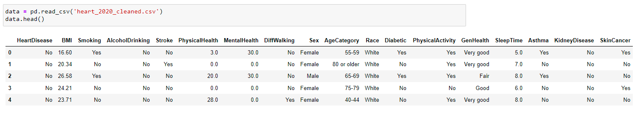
EDA (Exploratory Data Analysis)

Slide 4
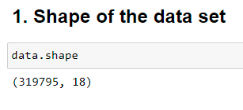
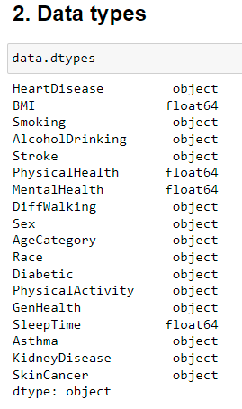
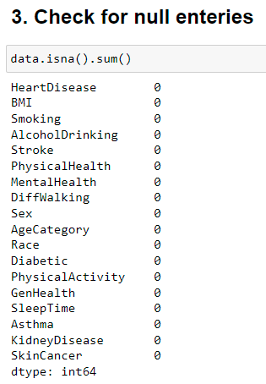
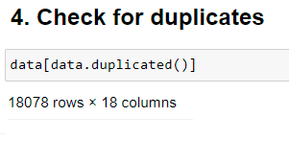
EDA

Slide 5
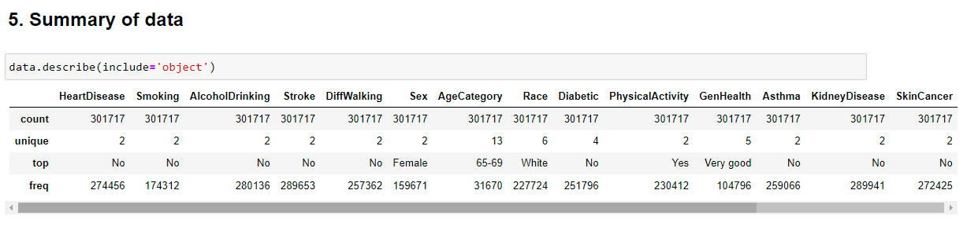
Data Summary

Slide 6
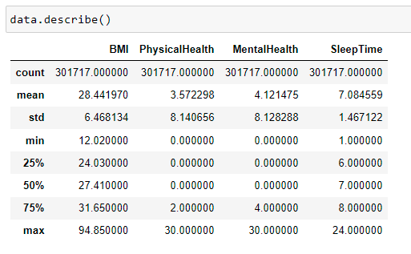
Data Summary

Slide 7
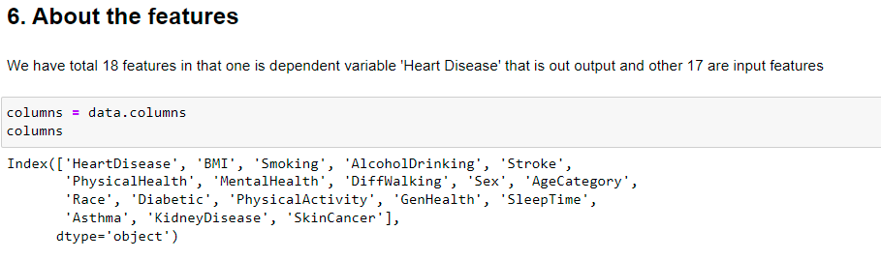
About the features

Slide 8

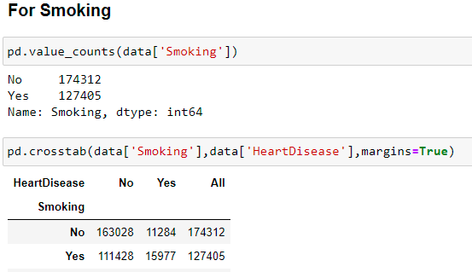
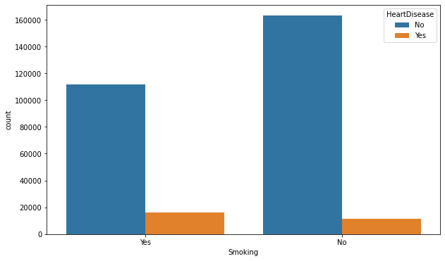
For smoking
Smoking VS Alcohol Drinking

Slide 9
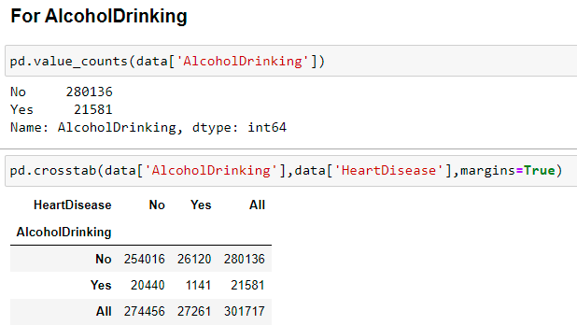
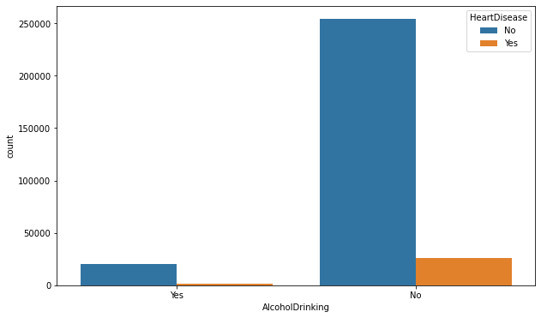
For Alcohol Drinking
Heart Disease VS Alcohol Drinking

Slide 10
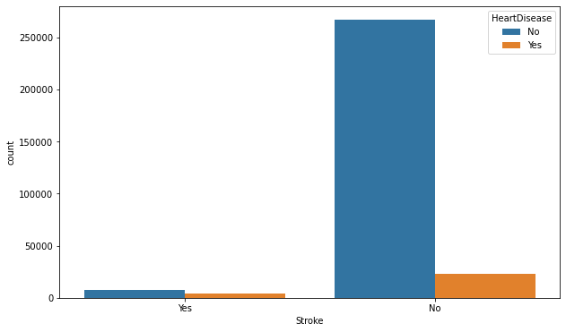
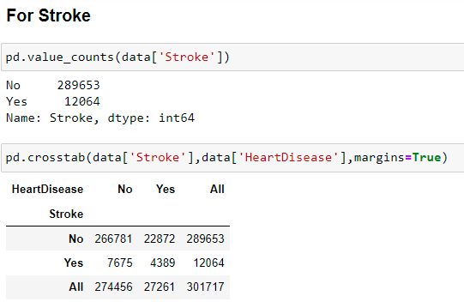
For Stroke
Heart Disease VS Stroke

Slide 11
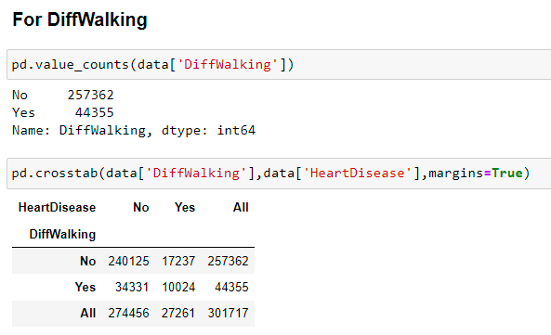
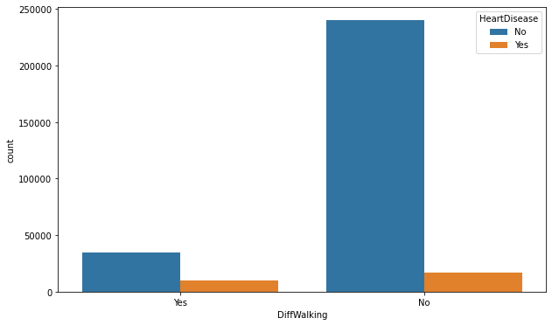
For Diff Walking
Heart Disease VS Diff Walking

Slide 12
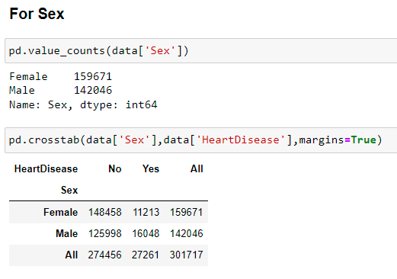
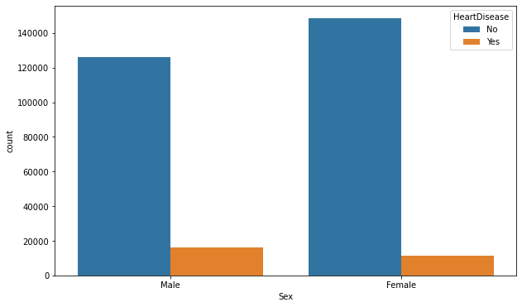
For Sex
Heart Disease VS Sex

Slide 13
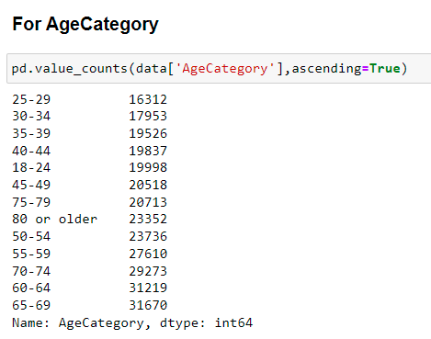
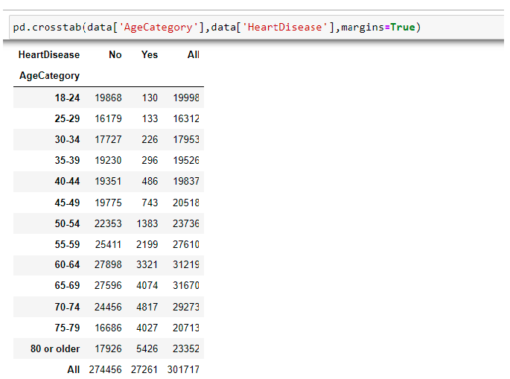
For Age Category
Heart Disease VS Age Category

Slide 14
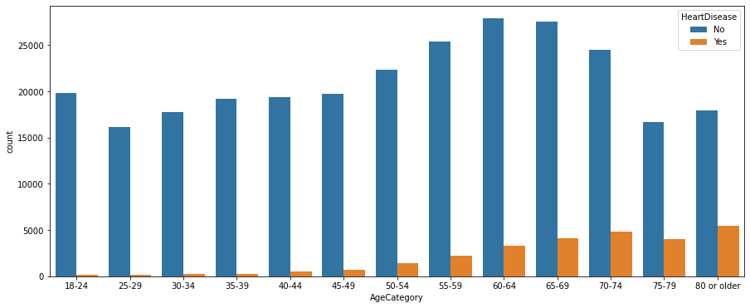
For Age Category
Heart Disease VS AgeCategory

Slide 15
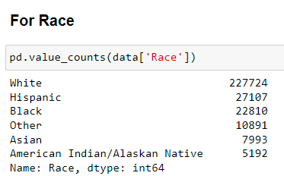
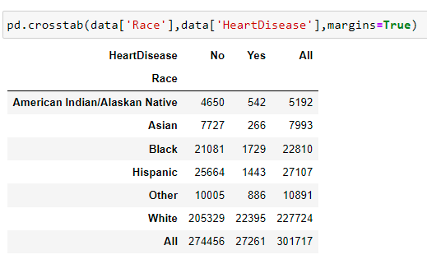
For Race
Heart Disease VS Race

Slide 16
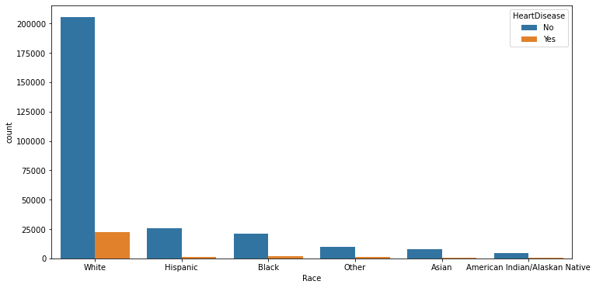
For Race
Heart Disease VS Race

Slide 17
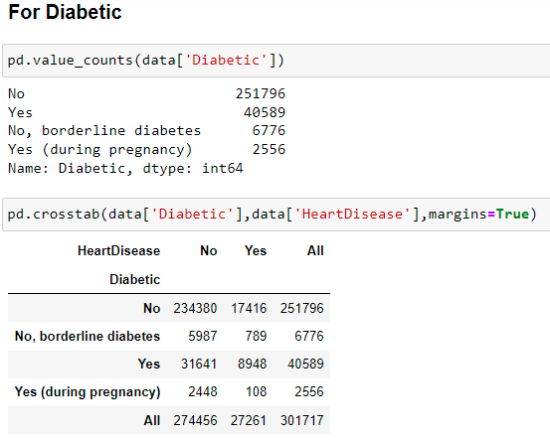
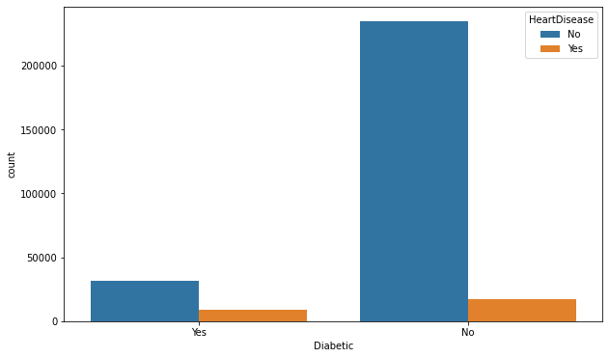
For Diabetic
Heart Disease VS Diabetic

Slide 18
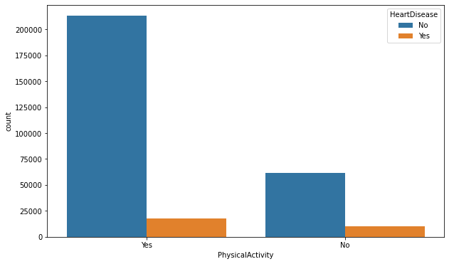
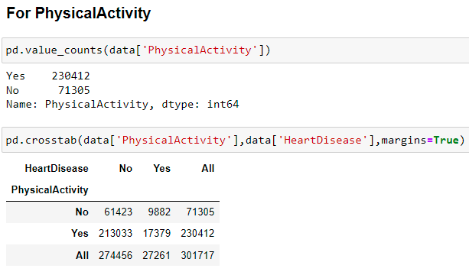
For PhysicalActivity
Heart Disease VS Physical Activity

Slide 19
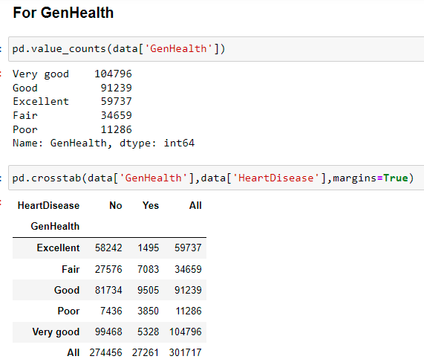
For GenHealth

Slide 20
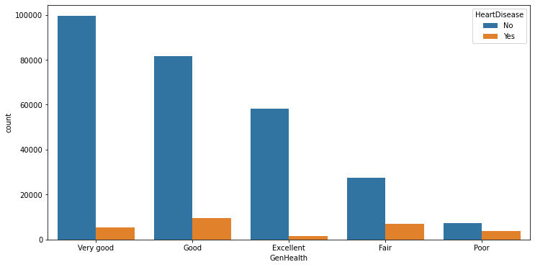
For GenHealth
Heart Disease VS Gen Health

Slide 21
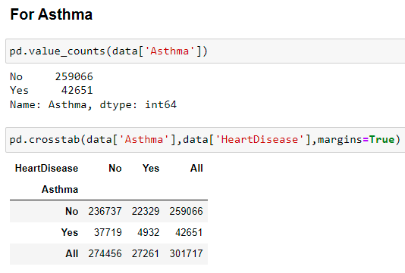
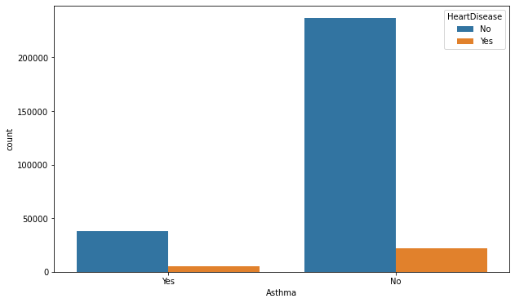
For Asthma
Heart Disease VS Asthma

Slide 22
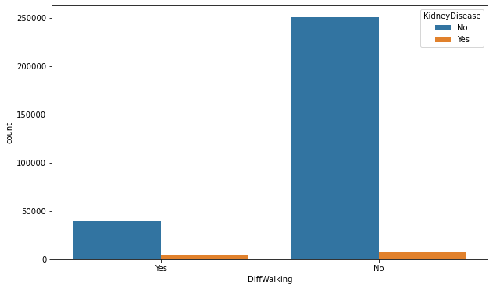
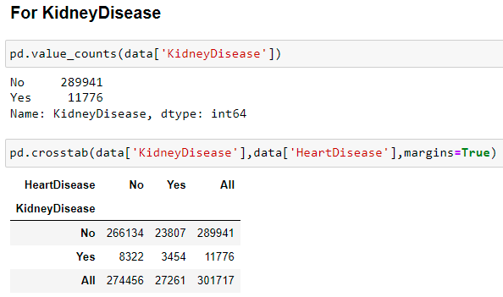
For KidneyDisease
Heart Disease VS Kidney Disease

Slide 23
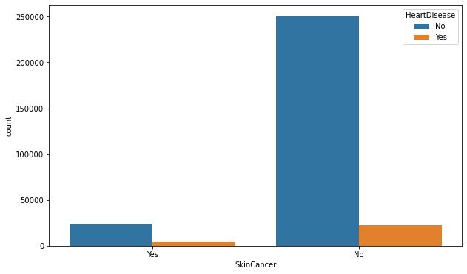
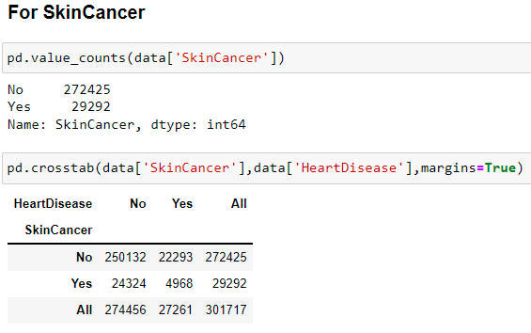
For SkinCancer
Heart Disease VS Skin Cancer

Slide 24

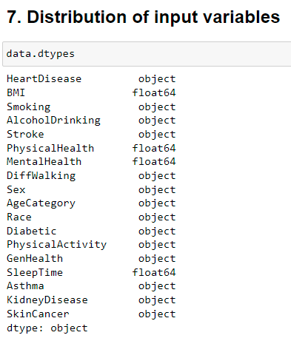
7. Distribution of input variables

Slide 25
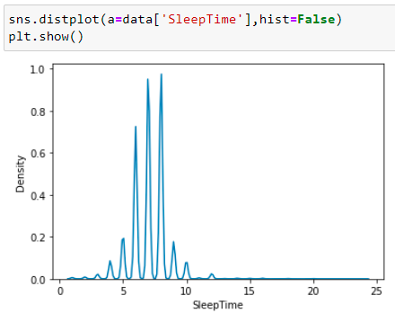
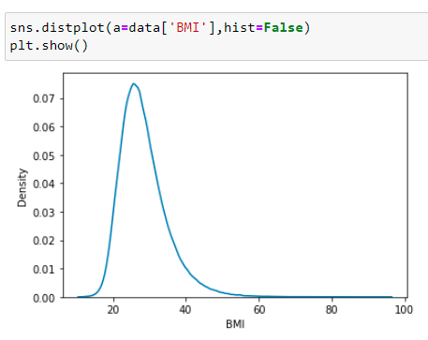
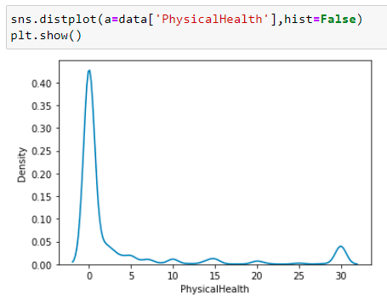
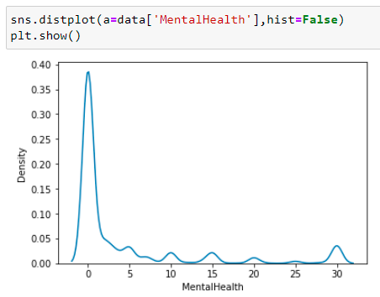
7. Distribution of input variables

Slide 26
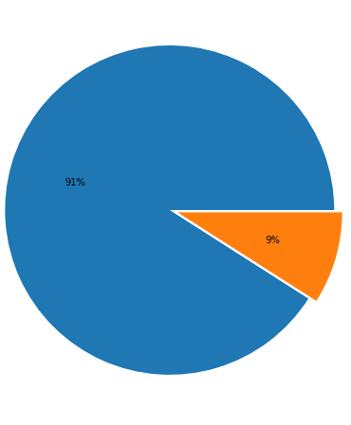
8. Checking for imbalance
Here we have 274456 observations who don't have Heart disease and only 27261 observations have Heart disease so its a highly imbalanced data with a proportion of 10:1

Slide 27

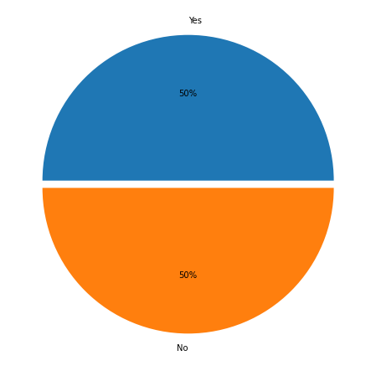
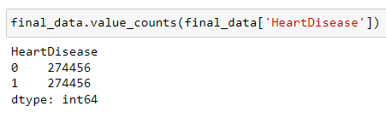
8. Checking for imbalance
Using over_sampling

Slide 28
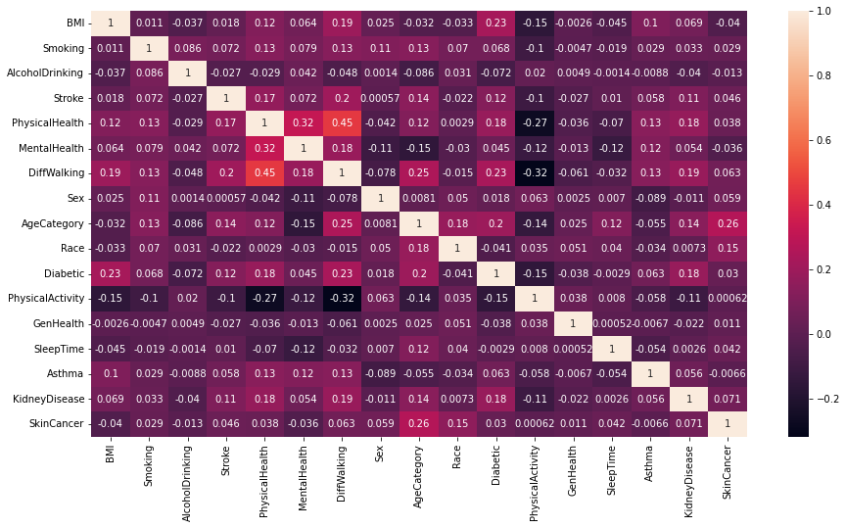
9. Correlation between the features and Feature importance

Slide 29
Model Selection
These are the models we are testing for our prediction
1. Logistic Regression
2.DecisionTreeClassifier
3.RandomForestClassifier
4.AdaBoostClassifier
5.GradientBoostingClassifier
6.XGBClassifier
7.LGBMClassifier
8.KNeighborsClassifier
9.GaussianNB

Slide 30
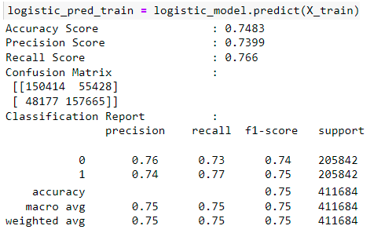
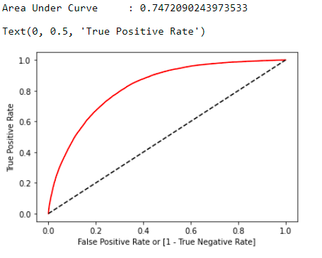
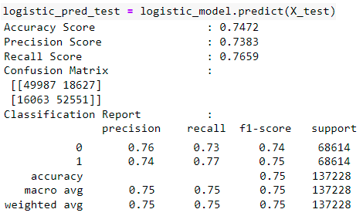
1. Logistic Regression

Slide 31
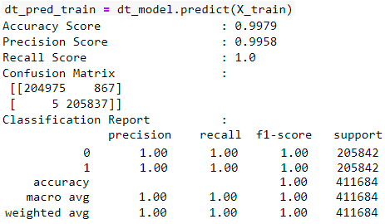
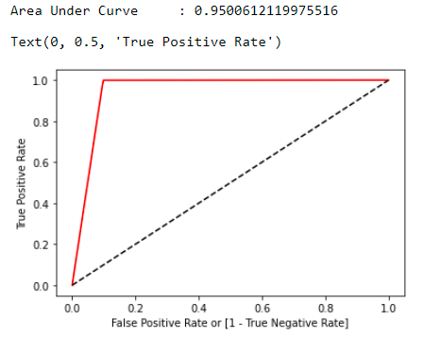

2. Decision Tree Classifier

Slide 32



3. Random Forest Classifier

Slide 33



4. Ada Boost Classifier

Slide 34



5. Gradient Boosting Classifier

Slide 35



6. XGB Classifier

Slide 36



7. LGBM Classifier

Slide 37



8. K Neighbor Classifier

Slide 38



9. Gaussian NB

Slide 39

Results Comparison
From above data frame its clear that for random forest we got better accuracy as well as precision and recall score.

Slide 40


Deployment

Slide 41
Conclusion
Input Features = 'BMI', 'Smoking', 'AlcoholDrinking', 'Stroke','PhysicalHealth', 'MentalHealth', 'DiffWalking', 'Sex', 'AgeCategory','Race', 'Diabetic', 'PhysicalActivity', 'GenHealth', 'SleepTime','Asthma', 'KidneyDisease', 'SkinCancer'
Output Feature = HeartDisease
Data Set Type = Balanced data set using Oversampling
Best Model = Random Forest
Train Accuracy Score : 0.9979
Test Accuracy Score : 0.9656
Classification Report : Precision recall f1-score support
0 1.00 0.93 0.96 68614
1 0.94 1.00 0.97 68614

Slide 42
Challenges
Too many duplicate data
Too many outliers
Data imbalance
Feature Selection
Model Selection
Deployment

Slide 43
Github Links
Bhupendra : https://github.com/bss1211/Project-122
Chinmai : https://github.com/Chinmai-D10/Heart-Disease-Prediction
Chandramohan : https://github.com/chandan0813/Heart-Disease-Prediction-p122-
Sairaj :
Sumit : https://github.com/SumitMasanaik/Heart-Disease-Prediction
Sunidhi : https://github.com/sunidhi-shetty/Project

Slide 44

Thank you

